Slide 1
Mutability & Immutability
In Java

Slide 2
Immutability
Immutable data are data whose state cannot be modified after they are created. This contrasts with mutable data, which can be modified after they are created.

Slide 3
Data type
Primitive
Array
Object
Function
Class

Slide 4
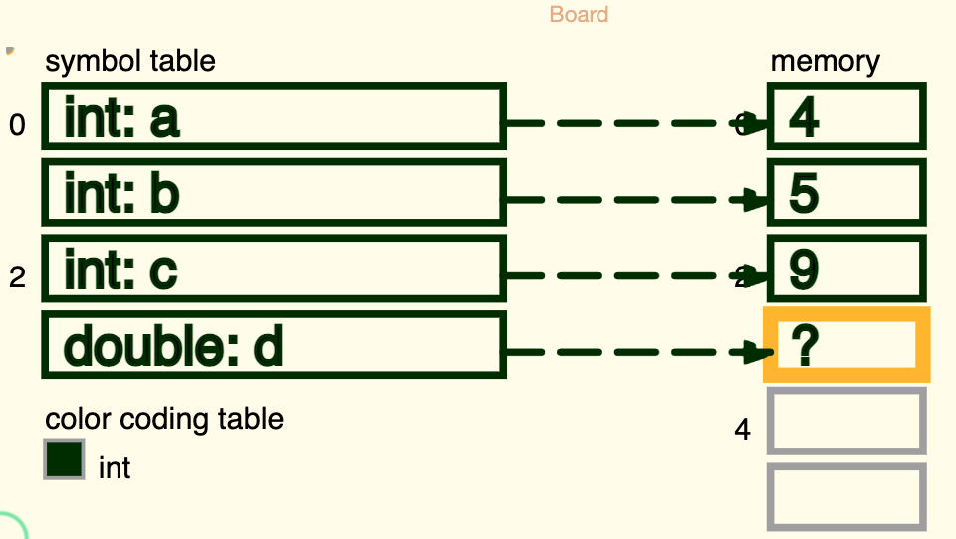
Primitive types

Slide 5
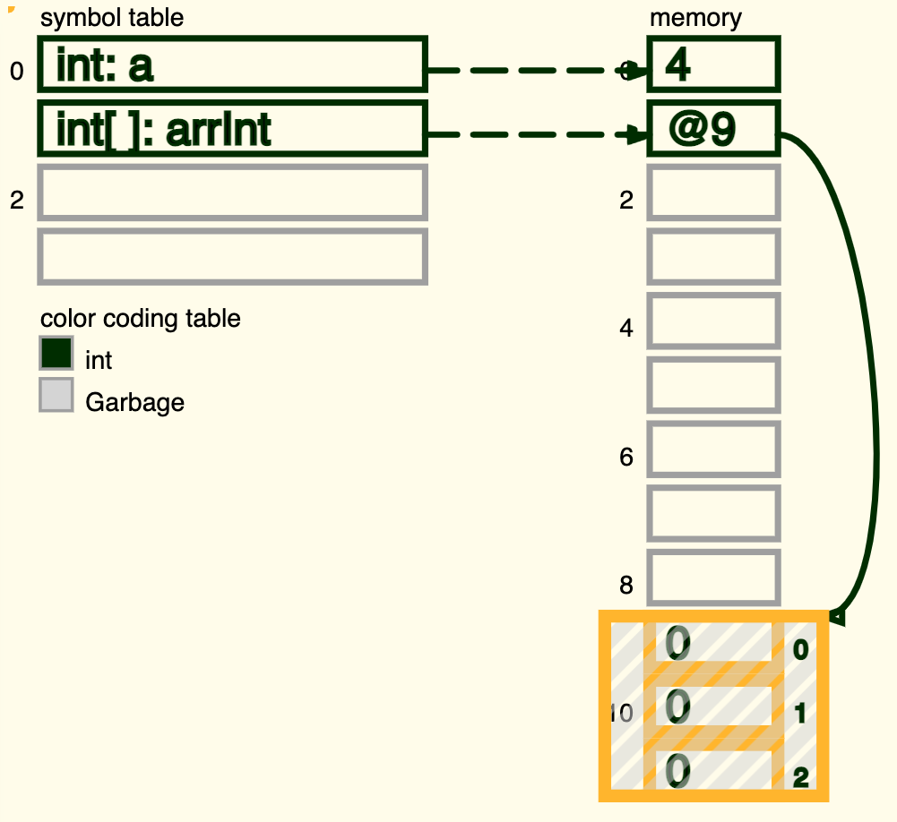
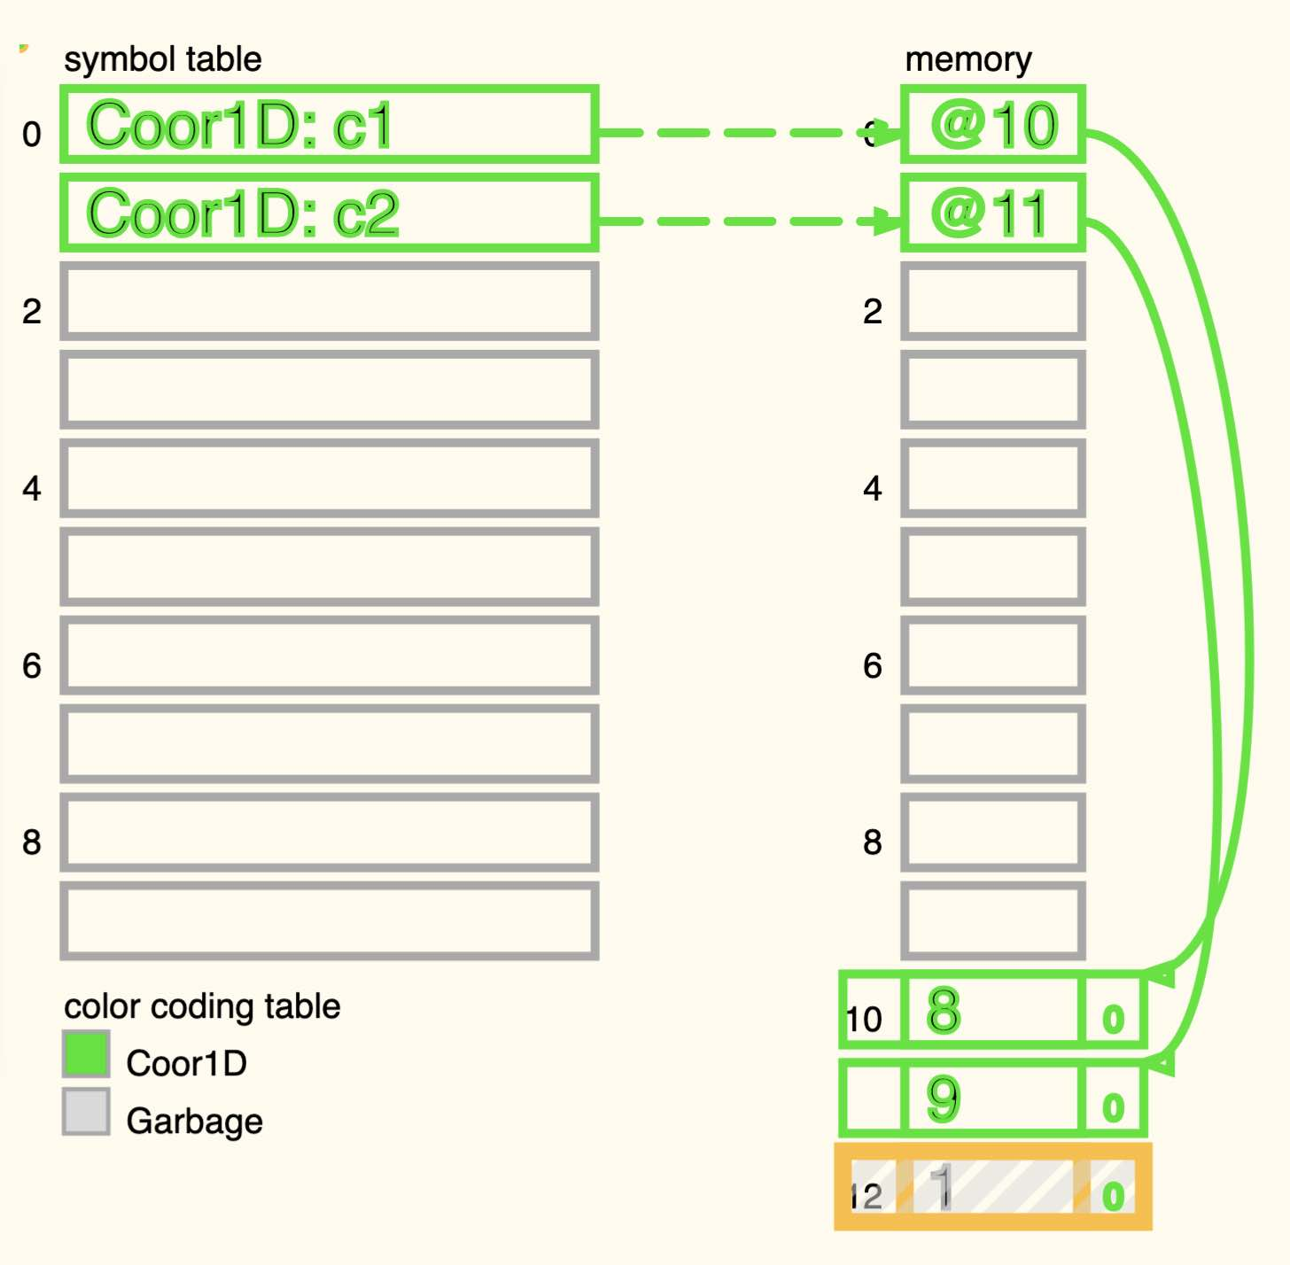
Array & Object

Slide 6
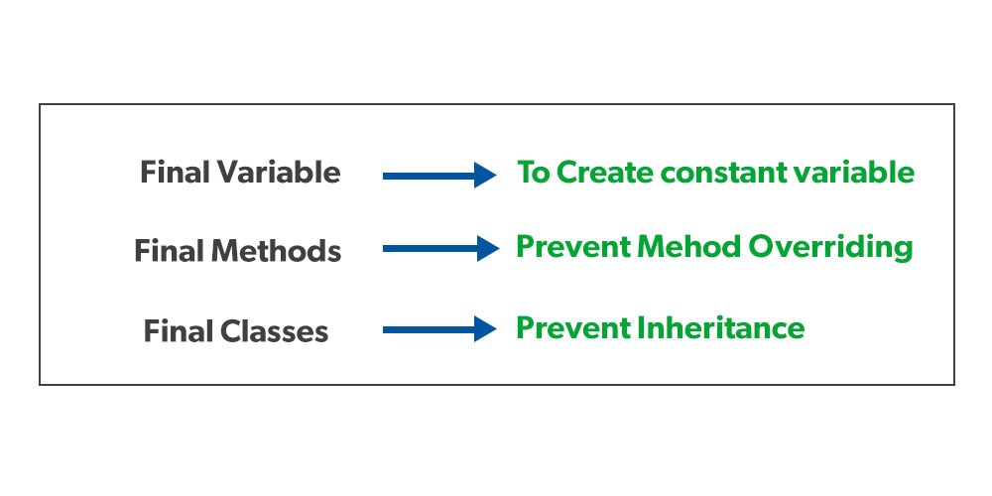
Keyword final

Slide 7
What is the problem with mutable data?
Side causes & Side effects
Thread safe

Slide 8
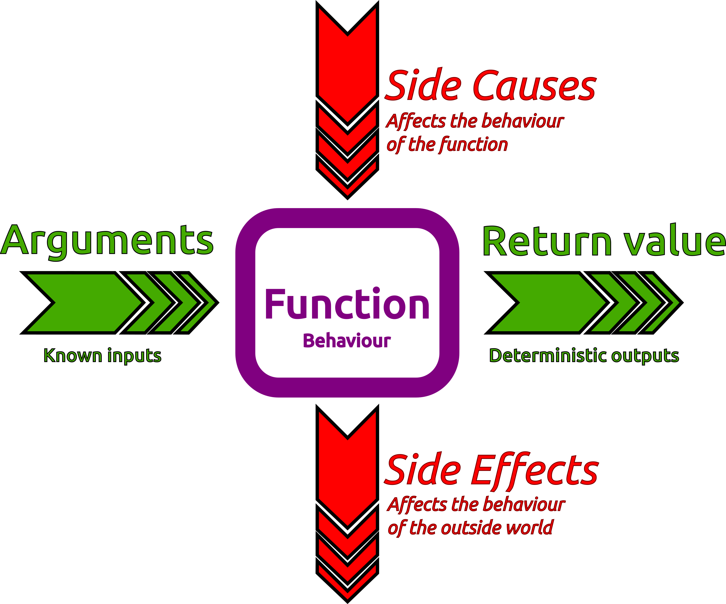
Side Effect
When the function changes the state of a variable outside its scope.
Side Causes – occurs when the rest of the system changes the behavior or the state of the function.
Side Effects – occurs when the function affects the rest of the system.

Slide 9
Thread safe
Immutability. Make the shared variables unreassignable or the shared data immutable.

Slide 10
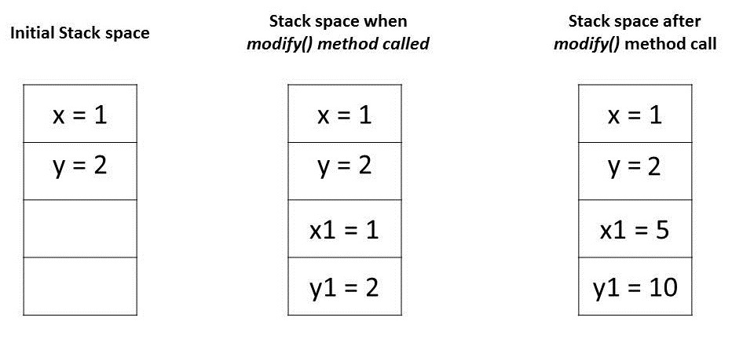
Pass-by-Value

Slide 11
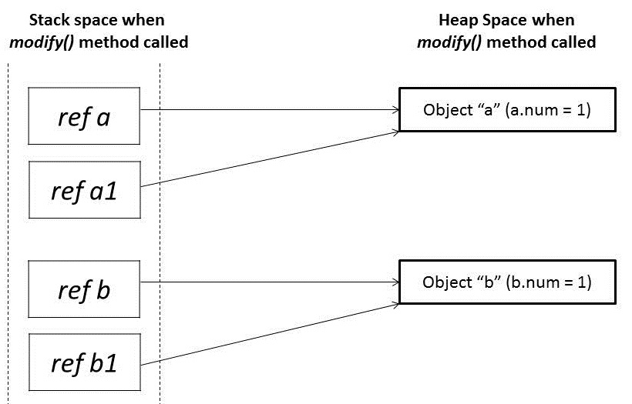
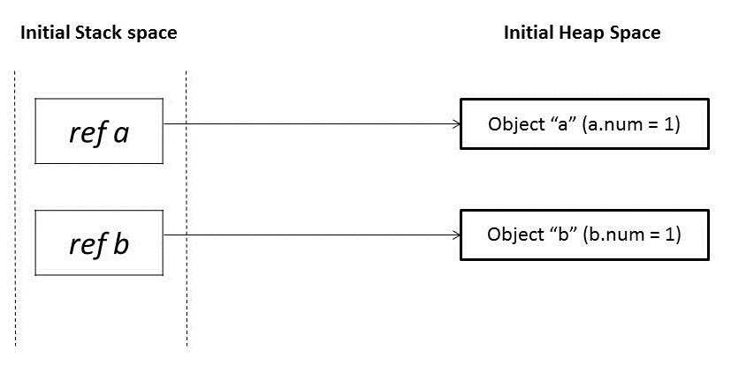
Pass-by-Reference

Slide 12
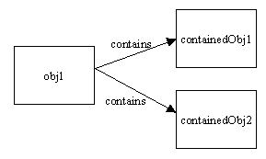
Copying

Slide 13
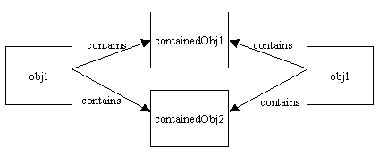
Shallow copying

Slide 14
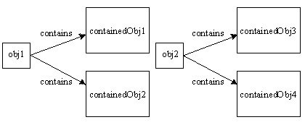
Deep copying

Slide 15
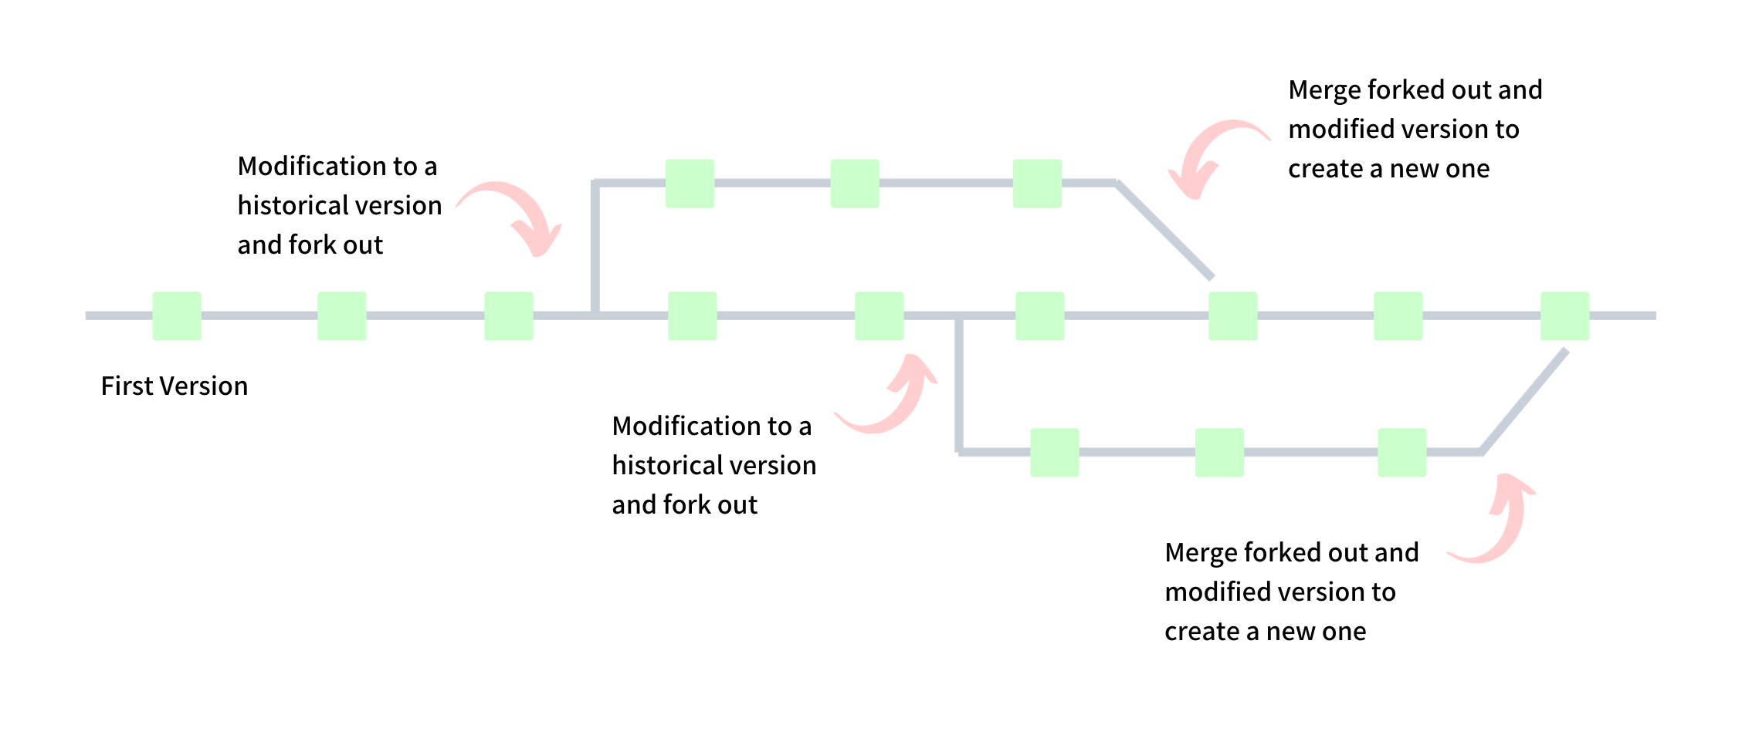
Persistent Data Structures

